Slide 1
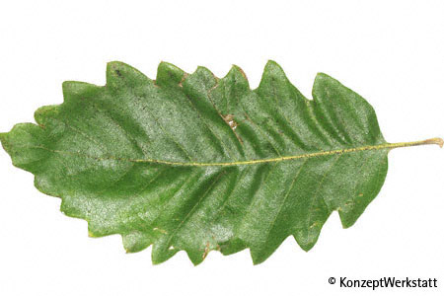
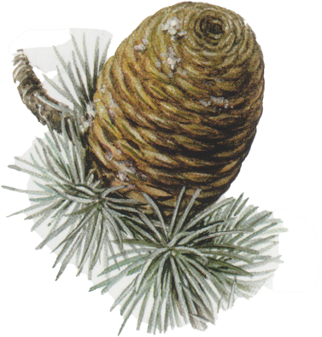
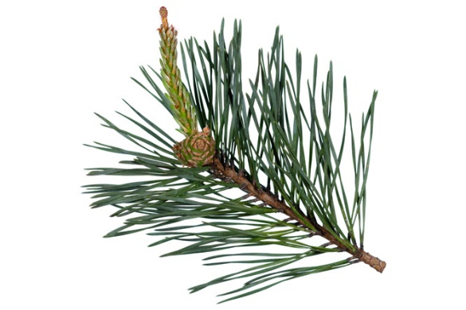
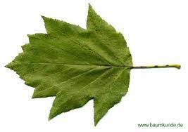
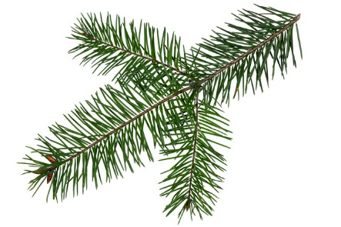
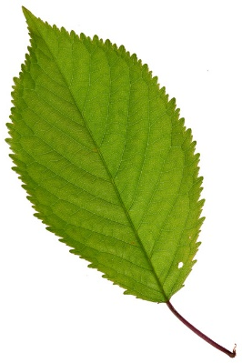
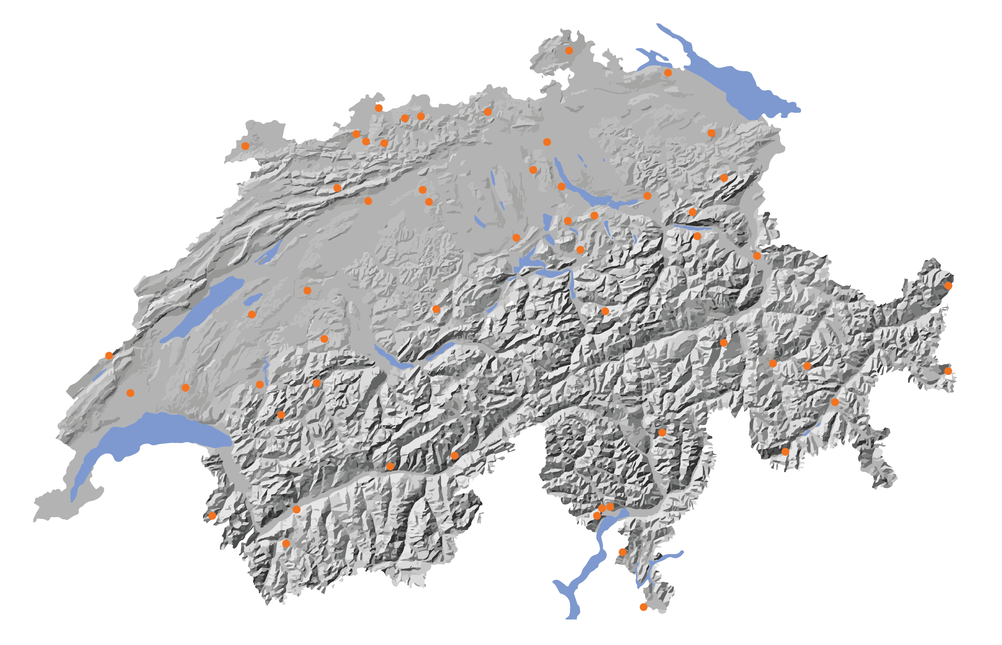
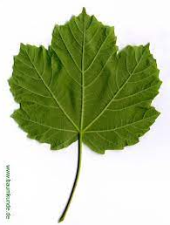
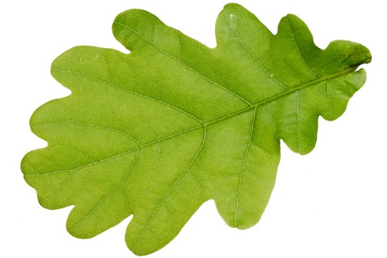
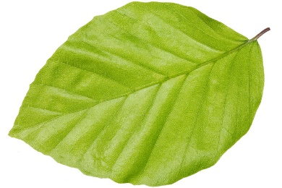
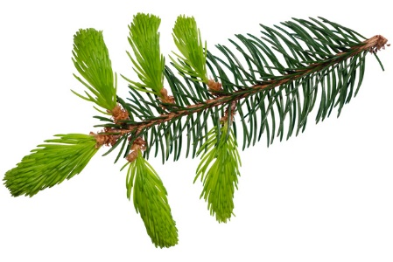
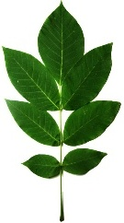

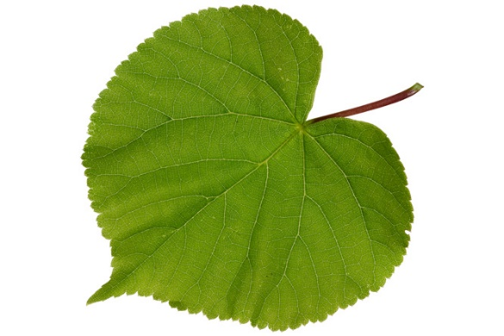

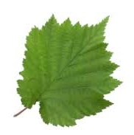
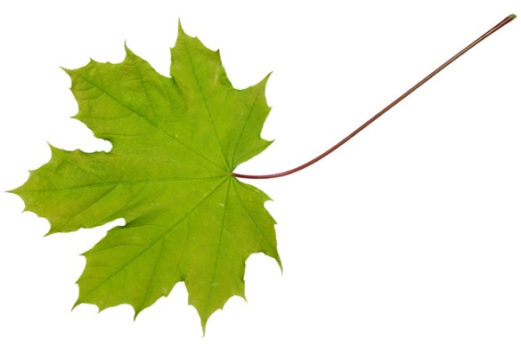
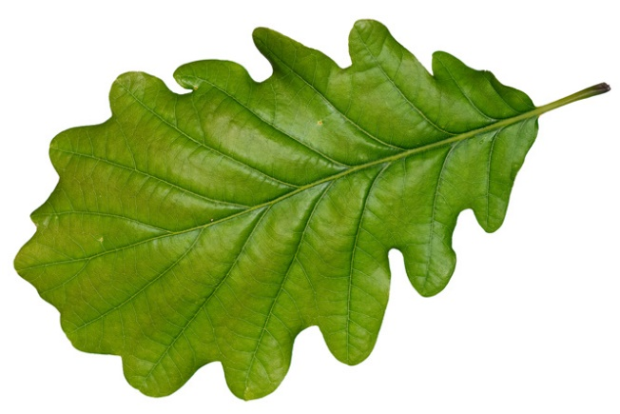
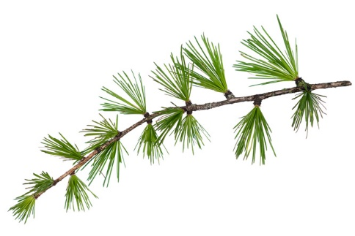
Swiss common garden network of future tree species Network for practice and research Jointly implemented by the FOEN, the cantons, forest owners, forest managers and WSL
Long-term goal: Recommendation of tree species for Swiss forest sites that thrive best with increasing climate change.
18 tree species
56 common gardens
Notes:
Messages:
The climate is changing – rapidly, within a single tree generation.
Forests are adaptable. However, natural adaptation takes a long time and we dependent on continuous forest goods and services - at least in certain areas.
Forests with a diverse mix of tree species and age groups (diverse structure) are better able to adapt to climate change than forests consisting of trees of the same age and species.
Tree species differ in their climate and soil requirements. We are finding out which tree species are sustainable in which locations. The federal government, cantons, forest owners, forestry operations, and the WSL are working together to develop recommendations for sustainable tree species.
A sustainable forest has future-fit tree species in its regeneration. Where these are lacking in regeneration, they can be introduced selectively through planting. The tree species composition can be influenced through targeted management.
The Swiss common garden network is open to projects from practice and research.
Further information:
More than 55,000 trees have been planted.
The question from practice is: Can tree species already be introduced today to locations where they will be considered suitable towards the end of the century?
The question from science is: Which environmental factors determine the survival, vitality, and growth of tree species?
The common gardens cover all regions, all forest-capable altitudes, and many soil types in Switzerland.
The highest common garden is situated in Samedan (1,820 m above sea level) and the lowest in Losone (250 m above sea level). The sessile oak is already being tested in Samedan.
Tree species in the core set are being tested on 35 areas: silver fir, sycamore maple, beech, larch, spruce, pine, Douglas fir, sessile oak, small-leaved lime
Tree species in the supplementary set are being tested on 15 sites: Italien maple, Norway maple, Atlas cedar, tree hazel, walnut, cherry, Turkey oak, English oak, service tree
Seeds from seven different provenances were collected for each tree species
We will be able to provide initial recommendations on where the tree species will grow and where they will not from 2025 onwards. From then on, we will publish results on plant survival and damage during the establishment phase. The first publication on growth in the juvenile phase is expected in 2028.

Slide 2
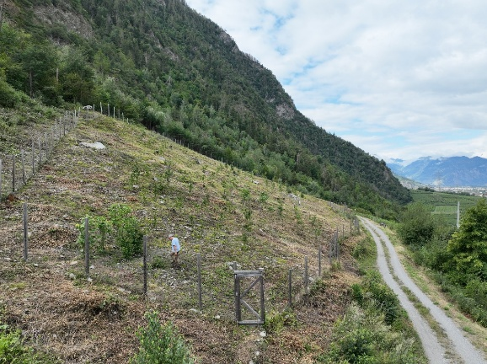
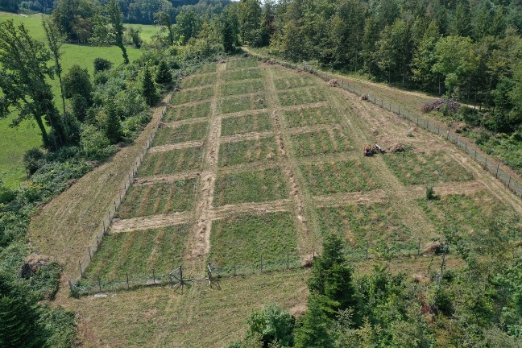
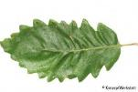










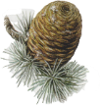



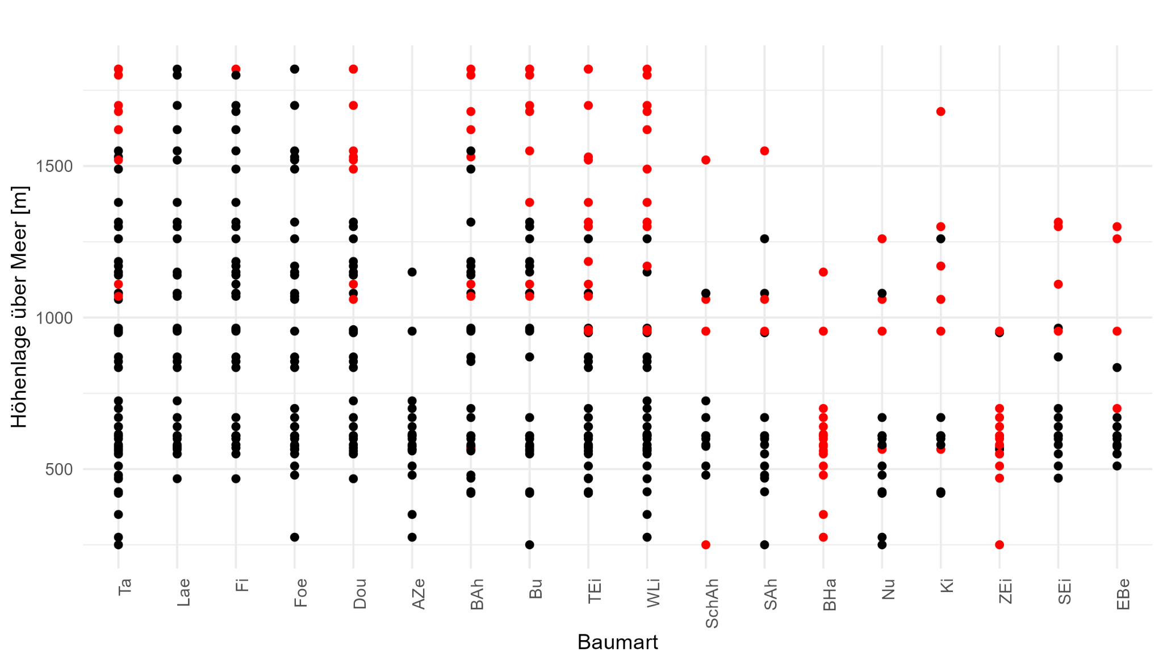
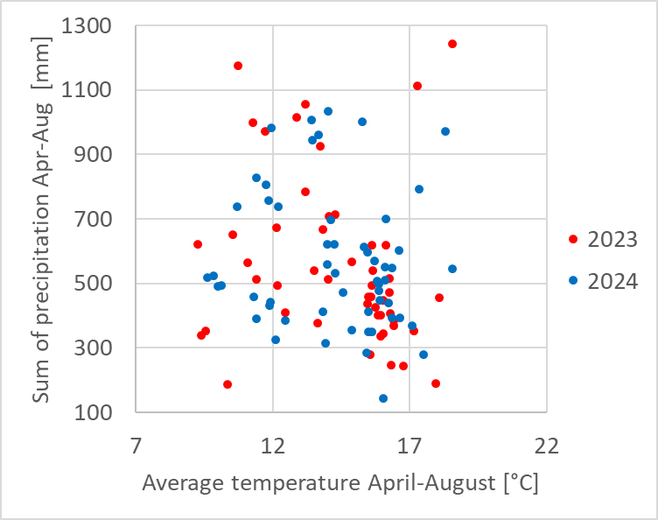



Swiss common garden network of future tree species
The network covers all regions, all forestable altitudinal levels and many soil types in Switzerland.
Riddes, Photo: Charvoz Mathieu
Pfeffingen, Photo: Jonas Vögtli
Notes:
Additional information:
The first figure shows the altitudes a species is tested. Red dots stand for sites where a species is tested outside of its habitat (higher in altitude or in another region, where it is not yet native), black dotes stand for sites where a species is tested within its habitat
The diagram shows the climatic distribution of the common gardens. The data comes from the climate stations on site.

Slide 3
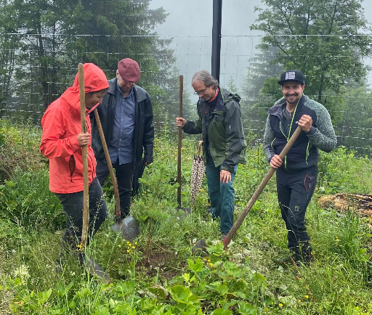
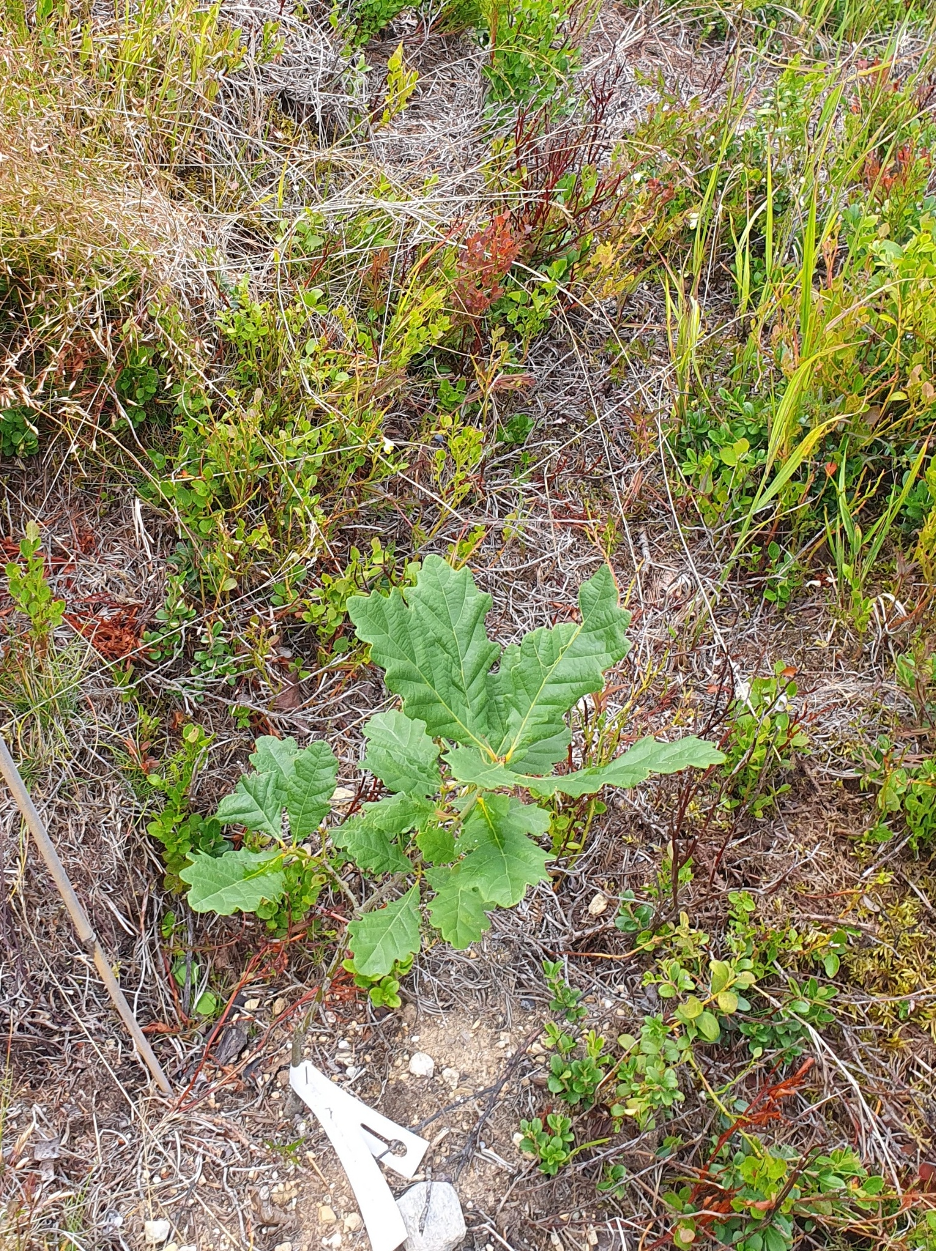
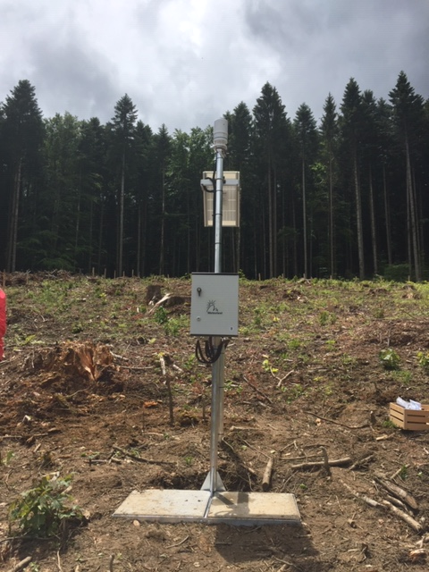
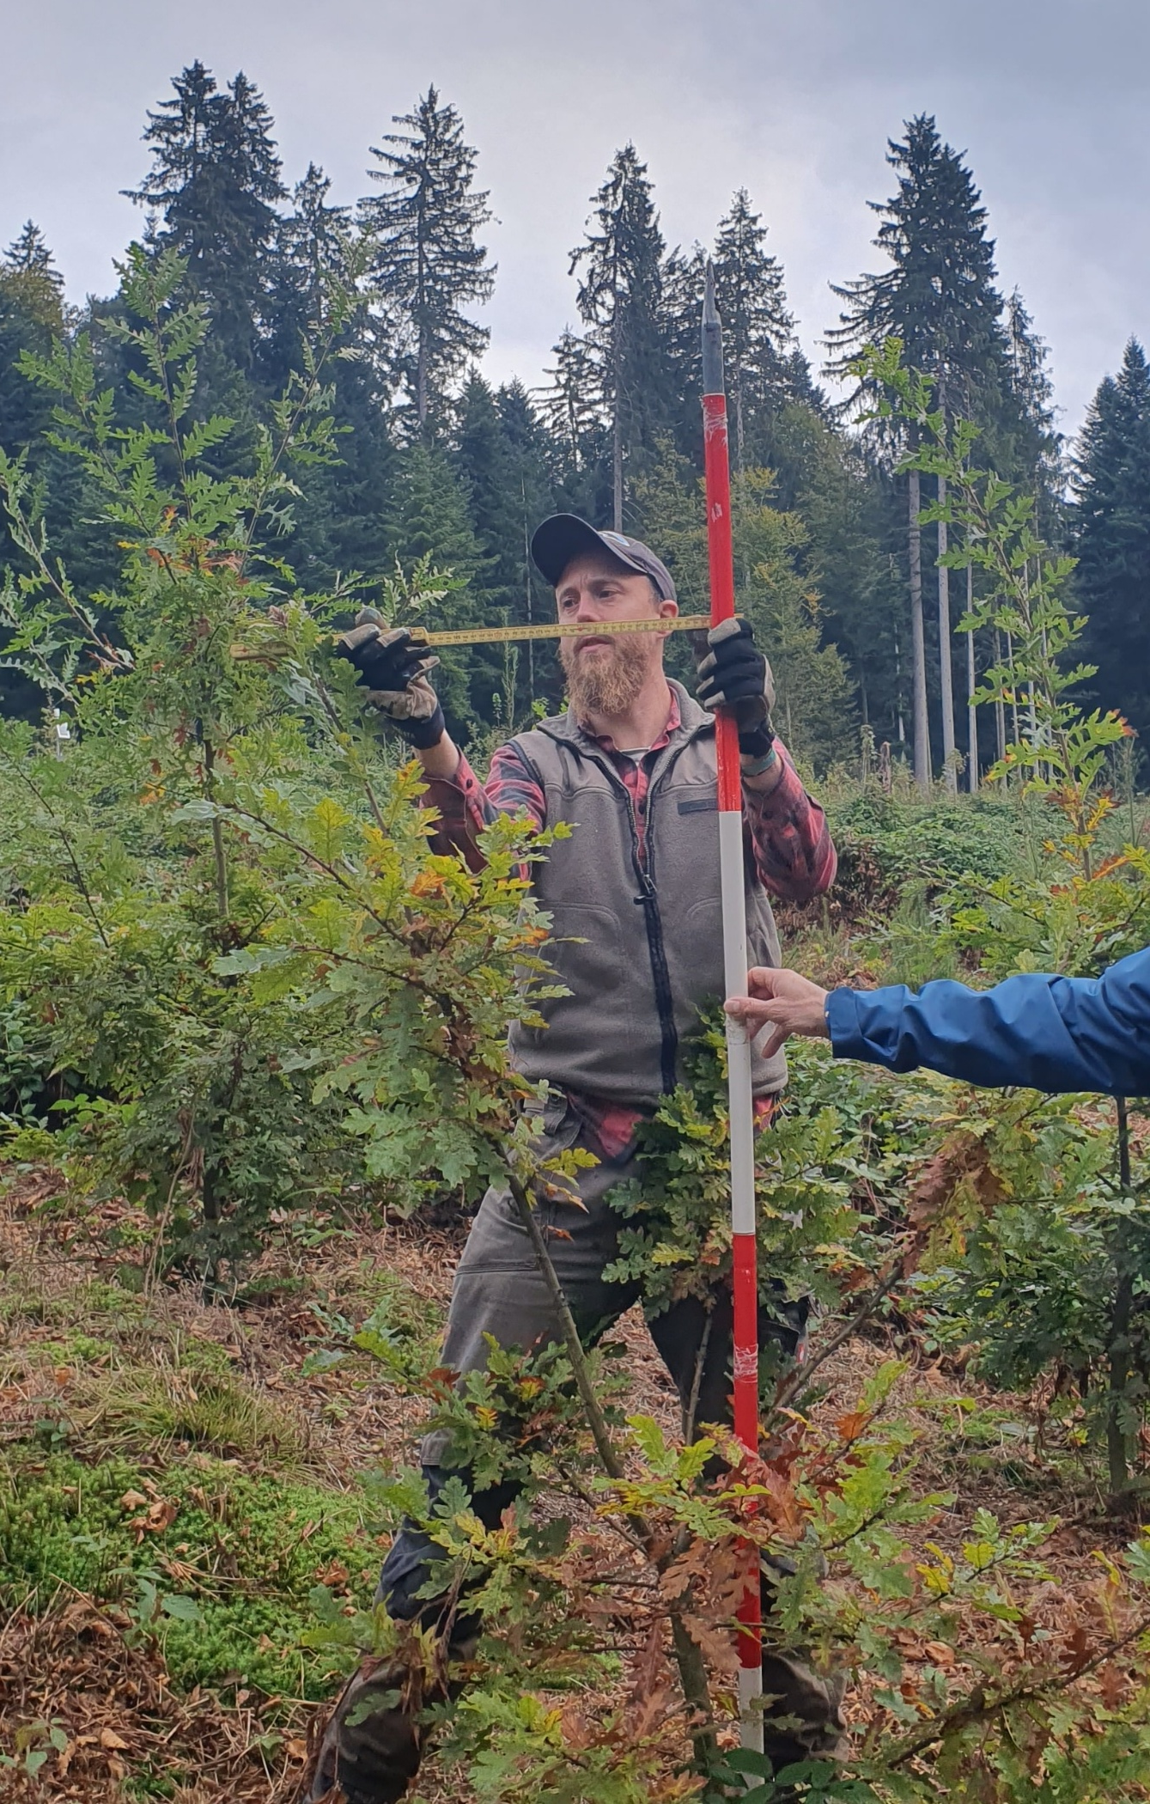
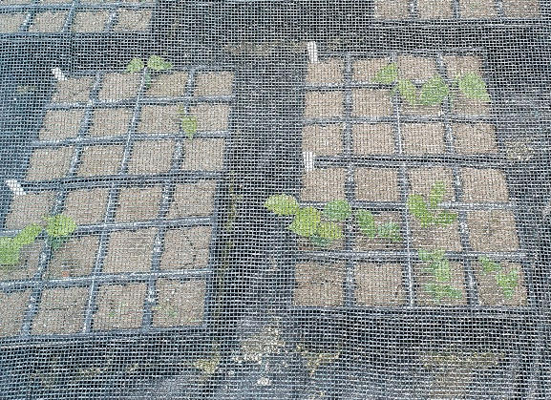
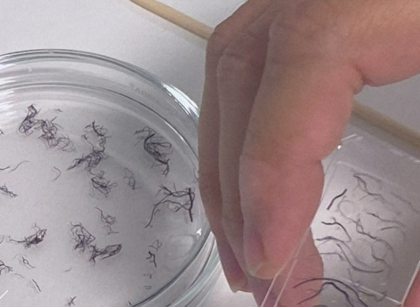
Swiss common garden network of future tree species
Procedure: We test tree species in their current distribution area and where the future climate is considered suitable for them, and collect data over 30-50 years on...
Champéry, Photo: S. Zurbuchen
Current Status
The last common garden was set up in spring 2023 Since summer 2023, the survival and vitality of all trees have been assessed annually Since autumn 2024, the growth of all trees has been surveyed every two years
… survival and vitality
… tree growth
… environmental conditions
Sessile oak near Samedan Photo: KS
Measuring Turkish oak, Photo: KS
Climate station, Bulle, Photo: MW
The network is open to projects and is used 6 additional projects are already using the common garden network. The latest one investigates interactions between soil communities and plants.
Germination experiment in Neuenegg, Photo: KS
Root tips, photo: Gemma Rütten
Notes:
The last site was established in Champéry in June 2023. Planting of the last tree in Champéry with Kathrin Streit, Jean-Christophe Clivaz (VS), Robert Jenni (FOEN) and François Vaudan (Triage forestier des Dents-du-Midi).
Since fall 2024, the growth of all plants has been recorded every two years: this means that we record the growth on half of the areas each year (and on the other half the following year).
The ecoloGy fRom belowGRound project is led by Gemma Rutten from the University of Bern. In 2024, the interactions between soil communities and six of our planted deciduous tree species were investigated on six test planting areas (including Neuenegg Photo). A follow up project is planed the proposal has been submitted to SNF in October 25. Other projects include the polytunnel experiment by Barbara Moser and the SwissBiomass project by Esther Thürig.

