Slide 1
hyperion
HPC@WSL
Notes:
Named after one of the sons of Uranus and Gaia from the greek mythology. Hyperion himself: father of Helios (Sun), Selene (Moon) and Eos (Dawn); together with his sister Theia

Slide 2
Why using hyperion
HPC: high performance computing
large computations
gain in computing time by parallelization
computational task that is broken down in…
several, often many
very similar
independently processed
…subtasks
Notes:
- keep in mind that subtasks with loads of I/O might not me best
- keep in mind that it is often better to have fewer subtasks with loads of work than loads of subtasks with almost no work to be done (loose efficiency because of communication)

Slide 3
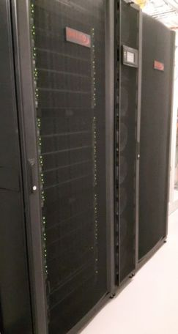
General Information
Dalco Cluster
Linux Operating System (CentOS 7)
Plant Protection Lab
Notes:
Dalco Switzerland sits in Volketswil; provide HPC-environments for industries (Novartis, UBS, Sauber F1, …) and universities (ETH, Zurich, Basel, …)

Slide 4
General Information
Master Node (1)
Compute Nodes (56)
Storage Server (2)
Omni-Path 100 GBit/s
Ethernet 2 x 10 GBit/s

Slide 5
Tech Specs
Master Node (1):
12 Cores
3.4 (3.7) GHz
64 GB Ram
1 TB local storage

Slide 6
Tech Specs
Compute Nodes (56):
20 Cores
2.2 (3.1) GHz
64 GB Ram
240 GB local storage
1120 cores
Notes:
- 64 / 20 gives 3.2GB Ram per core
- total memory of 1280GB Ram

Slide 7
Tech Specs
Storage Server (2):
16 Cores
2.2 GHz
32 GB Ram
24 SSD Disks (1.6 TB)
34 TB available
hard quota 400 GB
No Backup!
Notes:
Lustre Filesystem (distributed system)
Throughput: up to 9GB/s (expected ca. 5GB/s when multiple useres)
Hard quota can be raised termporarily (contact IT)

Slide 8
General Workflow
connect to the Master Node
copy your data to Storage Server
tell hyperion what to do on Computing Nodes
copy your data from Storage Server
No Backup!

Slide 9
How To
most information found on
http://hyperion.wsl.ch
contact us in case of questions
happy to help…
…up to a certain limit.
Notes:
Limit: both knowledge wise and time wise

Slide 10
How To: CONNECT
get an account from IT
see details on http://hyperion.wsl.ch
via ssh
Windows:
download, install, and use Putty: http://hyperion.wsl.ch/download
maybe better: linux subsystem
UNIX-alikes (Linux, MacOS, …)
built-in ssh
Notes:
Usual WSL-username and password
ssh wueest@hyperion
Contact me in case you want connection without password!

Slide 11
How To: RUN A JOB
SLURM:
Simple Linux Utility for Resource Management
job submission system => suit of commands
“[…] is very easy to learn and use.”
use sbatch command
call a batch script: testjob.slurm
Notes:
Cite IT from hyperion.wsl.ch/cluster

Slide 12
How To: BASIC BATCH SCRIPT
Basic structure
#!/bin/bash
sbatch arguments
organize data
run job
organize data
Notes:
Alternative to bash => csh

Slide 13
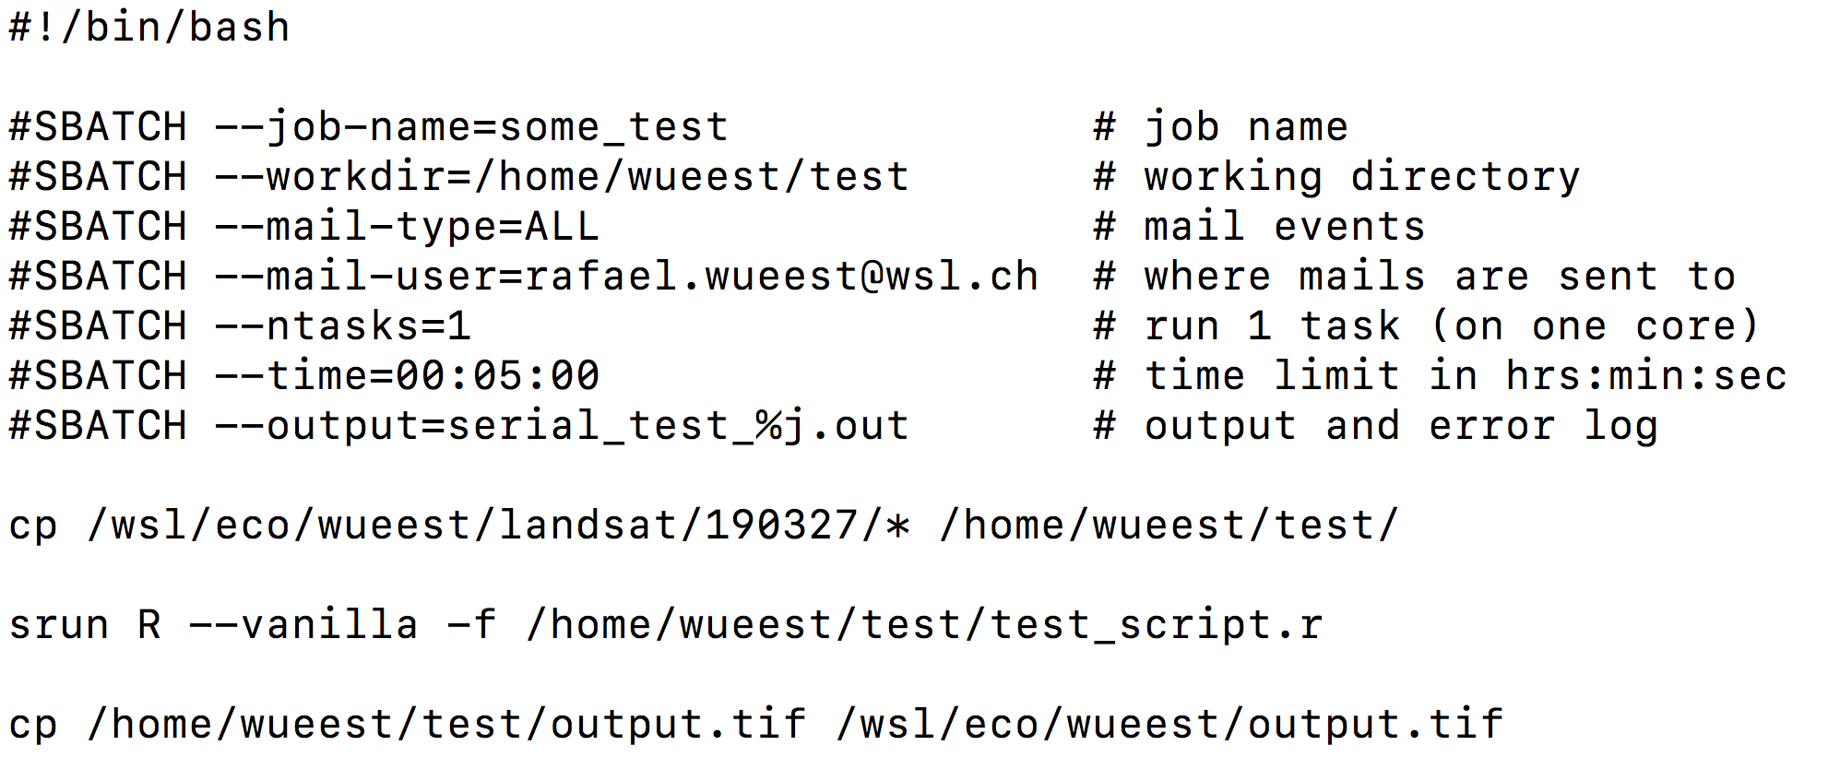
How To: BASIC BATCH SCRIPT
Notes:
- shell definition
- sbatch arguments => mail; ntasks; time
- copying => mention mounts: eco and lud11 and lud12
- srun to run serial job (ntasks=1)

Slide 14
How To: SET UP A BATCH SCRIPT
varieties of jobs
serial job(s)
array of jobs
parallel jobs
advanced configuration
several jobs
each of which with several CPUs

Slide 15
How To: SET UP A BATCH SCRIPT
varieties of jobs
serial job(s)
array of jobs
parallel jobs
advanced configuration
several jobs
each of which with several CPUs
examples

Slide 16
How To: SET UP A BATCH SCRIPT
all examples
produce a series of 16 files
each file named with an index i_{1..16}
can be of any format (*.txt, *.rdata, *.tif, *.ncdf, *.*)

Slide 17
How To: SET UP A BATCH SCRIPT
varieties of jobs
serial job(s)
array of jobs
parallel jobs
advanced configuration
several jobs
each of which with several CPUs

Slide 18
A simple R script (your «task») (that creates one indexed *.txt file)
# array_test.r
# Collect command arguments
args <- commandArgs(trailingOnly=TRUE)
args_contents <- strsplit(args, " ")
# set an output directory
OUTPUT <- ‘/wsl/lud11/username/’
# Get first argument
Index <- args_contents[[1]]
# write out a file containing the index value from the batch script.
write.table(Index, filename = paste(OUTPUT, Index, ’.txt’, sep = ‘’))

Slide 19
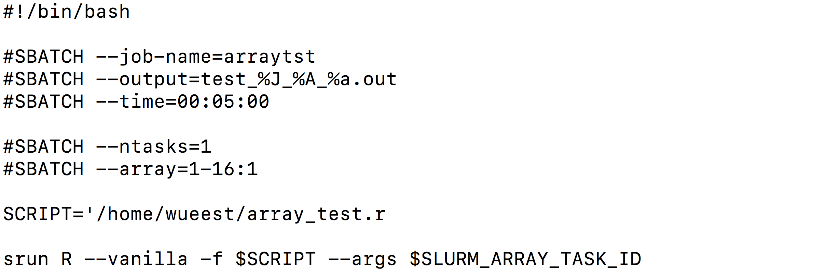
How To: ARRAY BATCH SCRIPT
Starts 16 R instances,
each of which gets
one CPUs assigned
and a unique SLURM_ARRAY_TASK_ID
Notes:
This calls 16 instances of R, each of which with a unique SLURM_ARRAY_TASK_ID assigned (which can be supplied as argument)

Slide 20
R script
1 CPU
1 CPU
1 CPU
1 CPU
1 CPU
1 CPU
1 CPU
1 CPU
1 CPU
1 CPU
1 CPU
1 CPU
1 CPU
1 CPU
1 CPU
1 CPU
Node 1
Result: 16 files: 1.txt, 2.txt, …, 16.txt

Slide 21
How To: SET UP A BATCH SCRIPT
varieties of jobs
serial job(s)
array of jobs
parallel jobs
advanced configuration
several jobs
each of which with several CPUs

Slide 22
A simple R script that uses foreach (and creates 16 *.txt files)
# test_mpi.r
# load packages
require(Rmpi) require(foreach)
require(doMPI)
# setup parallel backend to use all available
cl <- startMPIcluster()
registerDoMPI(cl)
#foreach loop
foreach(n = 1:16) %dopar%
{
write.table(n, filename = paste0(‘/home/wueest/mpitest/’, n, ’.txt’))
}
# close parallel backend
closeCluster(cl)
mpi.quit()
startMPIcluster() detects all available CPUs
foreach(…) in combination with %dopar% executes a for loop in parallel
needed to properly clean MPI cluster connection

Slide 23
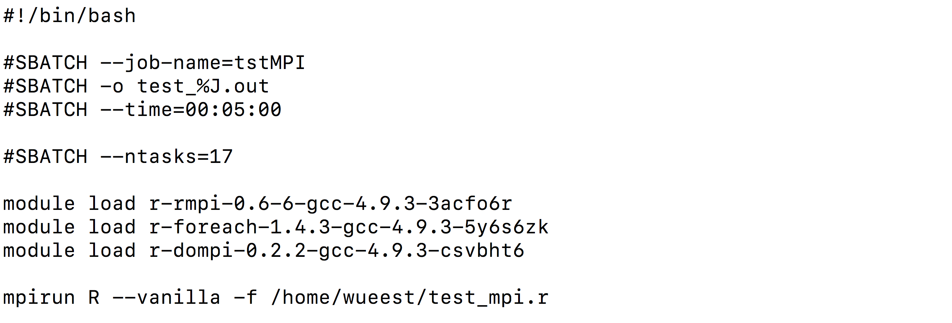
How To: PARALLEL BATCH SCRIPT
Starts one R instance,
which gets 16 CPUs assigned
(mpirun needs 1 CPU)
Notes:
R needs to be called with mpirun so that it gets to use all available CPUs
can be used in conjuction with, e.g., the foreach functionalities

Slide 24
R script
mpirun
Node 1
16 CPU
1
3
Result: 16 files: 1.txt, 2.txt, …, 16.txt

Slide 25
How To: SET UP A BATCH SCRIPT
varieties of jobs
serial job(s)
array of jobs (serial or parallel)
parallel jobs
advanced configuration
several jobs
each of which with several CPUs

Slide 26
A simple parallel mulitcore R script (that creates one geotiff raster)
# testscript.R
# Collect command arguments
args <- commandArgs(trailingOnly = TRUE)
args_contents <- strsplit(args, " ")
Index <- contents[[1]]
# load libraries
library(raster)
library(parallel)
# setup cluster that can be used by raster
beginCluster(10)
# read in a raster from ncdf file
st <- stack(“/wsl/lud/username/netcdffile.nc”, bands = Index:(Index + 1))
# get the mean of both rasters! IMPORTANT: THIS FUNCTION SHOULD BE ABLE TO RUN IN PARRALLEL. OTHERWISE YOU WONT USE THE 10 assigned to each R instance.
rx <- clusterR(st, calc, args = list(fun = mean))
# export raster to the random temporary directory
writeRaster(rx, filename = paste0(‘/wsl/lud11/username/’, Index,’.tif’), format = ‘GEOTiff’)
# stop the cluster (only stops the 20 R instances you created, not hyperion)
endCluster()
Reads rasters based
on the array-index

Slide 27
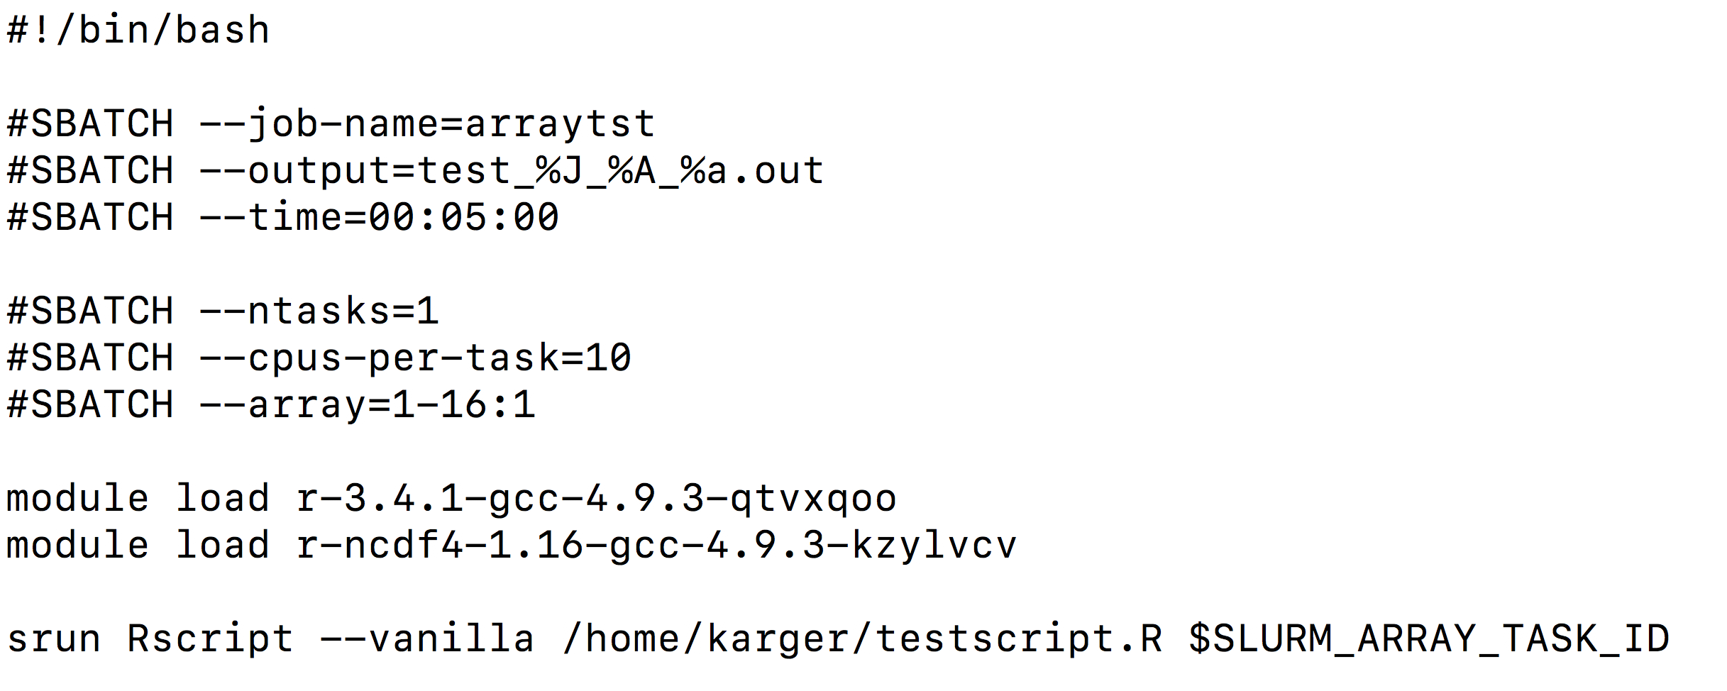
How To: ADVANCED CONFIG
Starts 16 R instances,
each of which gets
10 CPUs assigned
Notes:
Bsp from : /mnt/lud11/karger/hyperion/run_testscript.slurm

Slide 28
R script
Node 1
Node 2
Node 3
Node 4
10 CPU
10 CPU
10 CPU
10 CPU
10 CPU
10 CPU
10 CPU
10 CPU
Node 5
Node 6
Node 7
Node 8
10 CPU
10 CPU
10 CPU
10 CPU
10 CPU
10 CPU
10 CPU
10 CPU
Result: 16 geotiff raster: 1.tif, 2.tif, …, 16.tif

Slide 29
How To
most information found on
http://hyperion.wsl.ch
contact us in case of questions
happy to help…
…up to a certain limit.
Notes:
Limit: both knowledge wise and time wise

Slide 30
Thank you!
Dirk N. Karger
dirk.karger@wsl.ch
Rafael Wüest Karpati
rafael.wueest@wsl.ch

Slide 33
How To: INTERACTIVE SESSION
using srun

Slide 34
How To: ARRAY BATCH SCRIPT
Starts 16 R instances,
each of which gets
one CPUs assigned
and a unique SLURM_ARRAY_TASK_ID
Notes:
This calls 16 instances of R, each of which with a unique SLURM_ARRAY_TASK_ID assigned (which can be supplied as argument)

Slide 35
R script
Node 1
ntask=16
ntask=16
ntask=16
ntask=16
ntask=16
ntask=16
ntask=16
ntask=16
ntask=16
ntask=16
ntask=16
ntask=16
1 CPU
1 CPU
1 CPU
1 CPU
Result: 256 files: 1_1.txt, 1_2.txt, …, 16_16.txt

